Slide 1
Prompt Payment

Slide 2
WHO WE ARE
The Construction Association of Nova Scotia (CANS) will be the leading voice of the construction industry respected by members, government, industry and the public as a provider of the highest quality and value added services.

Slide 3
WHO WE REPRESENT
Over 780 member companies engaged in the non-residential construction industry across Atlantic Canada
Represent more than $3.8 billion of GDP in Nova Scotia
30,000+ men and women across Nova Scotia

Slide 4
WHY ARE WE HERE TODAY?
To discuss an important initiative, Prompt Payment Legislation.
To tell you about the Prompt Payment Coalition of Nova Scotia.
To seek your commitment to enacting Prompt Payment Legislation before the end of 2018.

Slide 5
WHAT IS PROMPT PAYMENT?
Prompt Payment Legislation sets out the rights and responsibilities of all parties to a construction project through the establishment of minimum standards for payment, dispute resolution and communication.

Slide 6
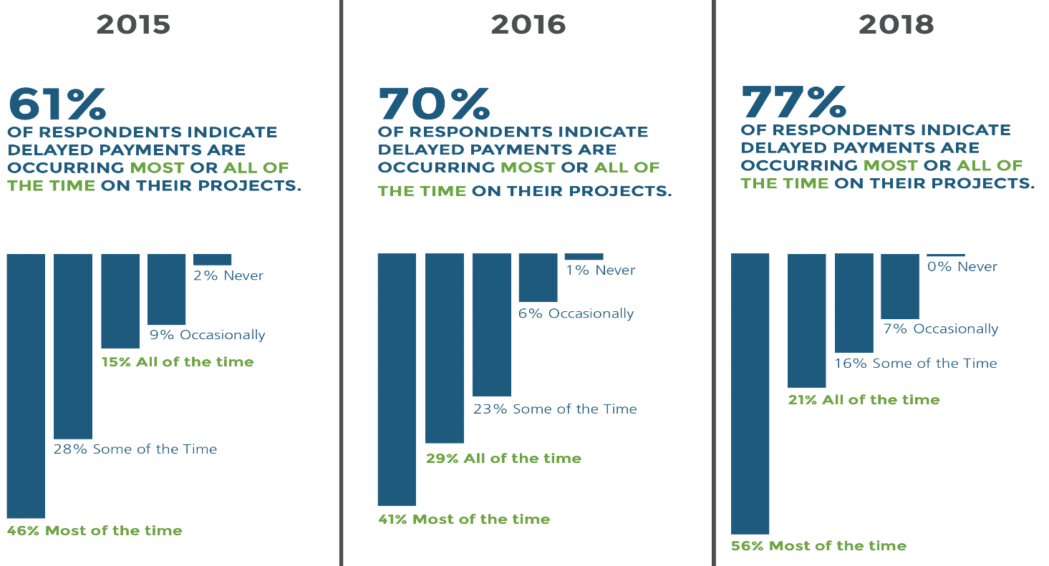
WHY PROMPT PAYMENT LEGISLATION – THE PROBLEM?
Delinquent payment is rampant and is a growing problem.

Slide 7
WHY PROMPT PAYMENT LEGISLATION – THE PROBLEM?
Contractors are commonly made to wait for periods of three months or longer to get paid for work that has been certified as being complete. This represents an unfair transfer of financial risk from buyers of construction to contractors (those who can least afford it yet create jobs, employ workers, and drive the economy).

Slide 8
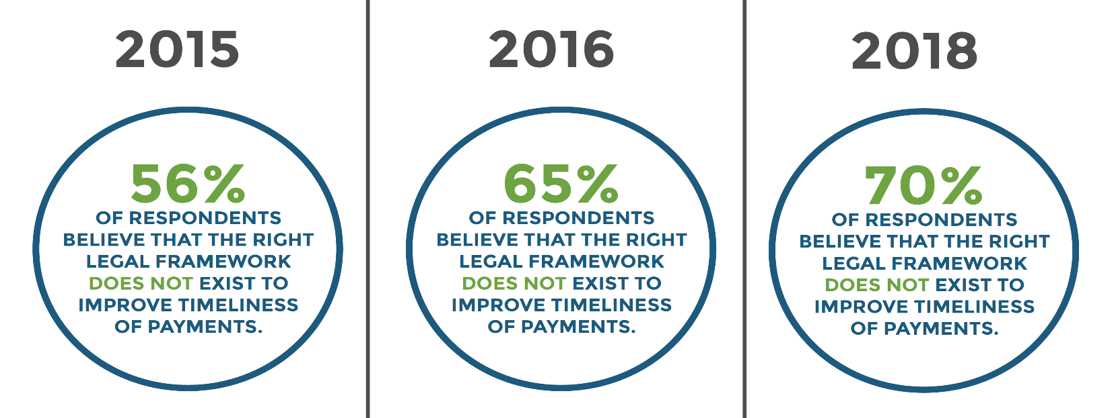
WHY PROMPT PAYMENT LEGISLATION – THE PROBLEM?

Slide 9
WHY PROMPT PAYMENT LEGISLATION – THE PROBLEM?
Nova Scotia and Canada lag behind a majority of other jurisdictions who already have prompt payment legislation in place – 49 US states have it for public sector projects, 31 US states have it in place for the private sector, the US federal government has had prompt payment legislation in place since 1982, the European Union, United Kingdom, Ireland, New Zealand, and Australia all have prompt payment legislation.

Slide 10
WHY PROMPT PAYMENT LEGISLATION – THE PROBLEM?
The existing law in Nova Scotia, the Builders Lien Act (BLA), is costly, cumbersome, and inaccessible to 65% of the construction industry (small and medium-sized family-owned companies consisting of 50 or fewer employees) – it addresses non-payment as opposed to delinquent payment and the lien rights of many in the industry will expire long before they realize they will not get paid.

Slide 11
WHY PROMPT PAYMENT LEGISLATION – THE CONSEQUENCES?
Delinquent payments hurt the Nova Scotia Economy.
When payments are delayed to contractors or suppliers at any level of the construction pyramid, critical processes break down, costs inflate, and there are severe consequences for people whose livelihoods depend on our industry.

Slide 12
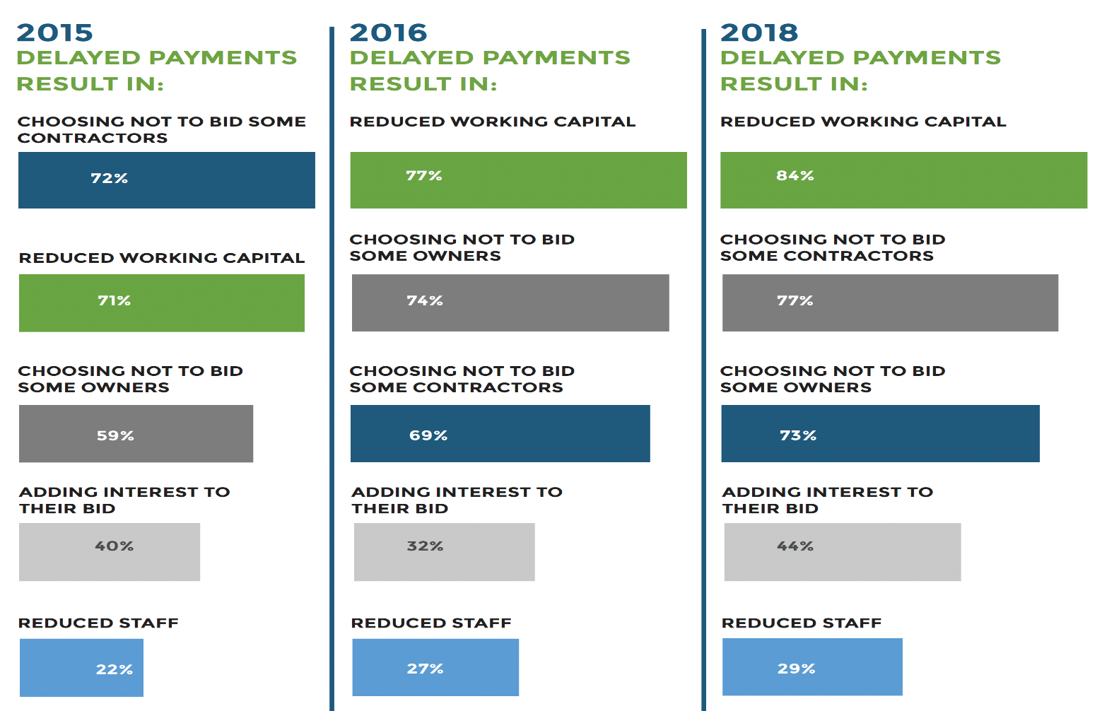
WHY PROMPT PAYMENT LEGISLATION – THE CONSEQUENCES?

Slide 13
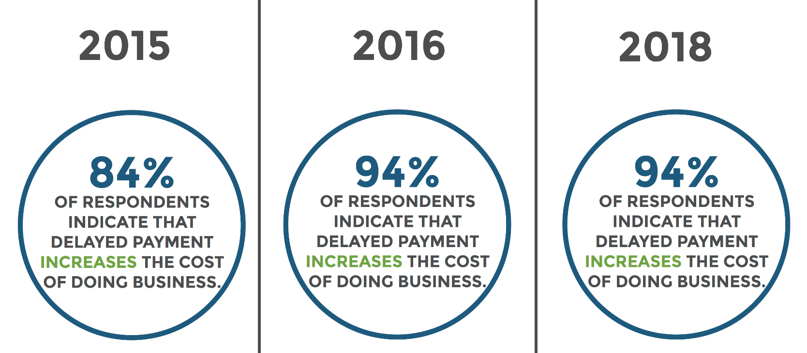
WHY PROMPT PAYMENT LEGISLATION – THE CONSEQUENCES?
Delinquent payment increases operational costs for Nova Scotia Businesses.

Slide 14
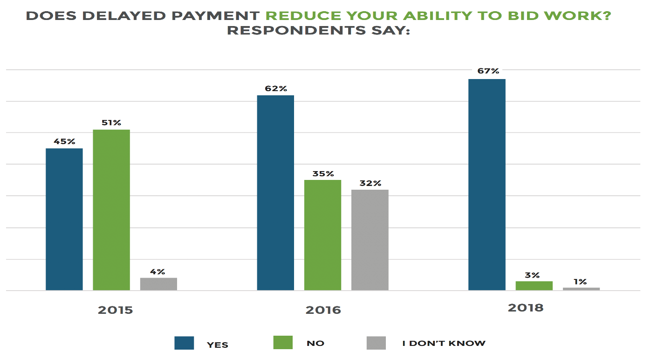
WHY PROMPT PAYMENT LEGISLATION – THE CONSEQUENCES?
Delayed payments reduce the ability of Nova Scotia firms to bid work and grow their businesses.

Slide 15
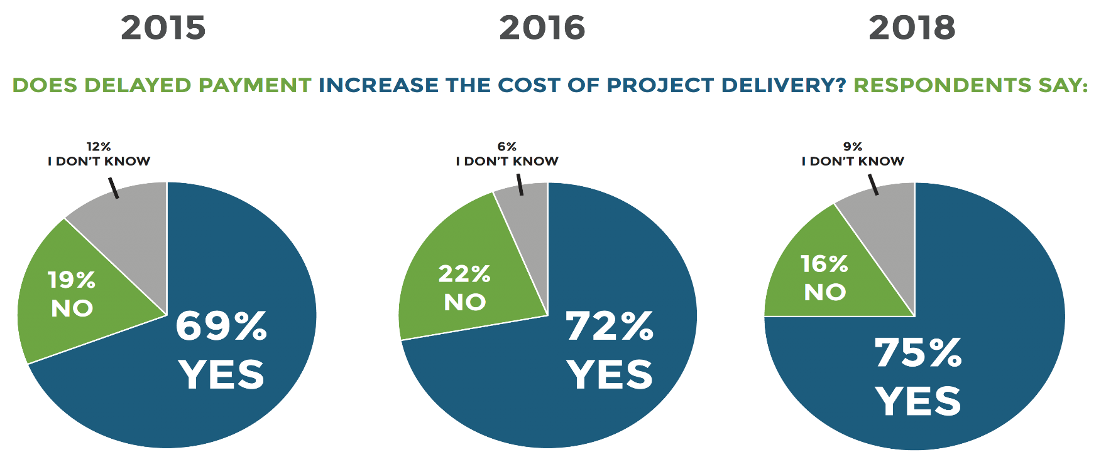
WHY PROMPT PAYMENT LEGISLATION – THE CONSEQUENCES?
Delinquent payment drives up the cost of construction as contractors have to factor the risk of delinquent payment into their bids.

Slide 16
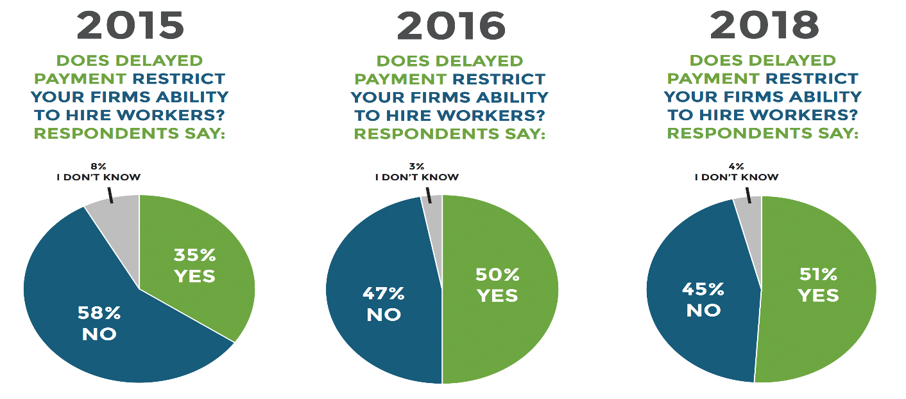
WHY PROMPT PAYMENT LEGISLATION – THE CONSEQUENCES?
Delinquent payment stymies new job creation and restricts investment in apprenticeship training (the construction industry accounts for roughly 40% of all apprenticeships) as trade contractors must limit their payroll commitments to meet cash flow expectations.
Late payment practices erode the level playing field as those who maintain honourable practices are put at a disadvantage.

Slide 17
CURRENT LANDSCAPE NATIONALLY
On a federal level, prompt payment will be introduced to parliament in the Fall, with focus on what Ontario is currently doing.
Several other provinces currently have prompt payment initiatives in the works. Saskatchewan is in its 2nd reading, with a 3rd amended reading likely happening in the Fall. The NB Law Amendments Commission has recommended a Prompt Payment Act be implemented. Manitoba, BC and Quebec are all pursuing prompt payment legislation as well.

Slide 18
PROMPT PAYMENT ACT
Why are these changes important?
Improves the movement of money in our economy.
Increases fairness and transparency.
Increases efficiency and productivity.
Lowers the cost of construction projects, public and private.
Reduce burden on our judicial system.
Will drive investment, employment, training, innovation and purchase of equipment (ie. apprentices).
Increase competition and number of bidders on public work
Allow contractors to bid more work.

Slide 19
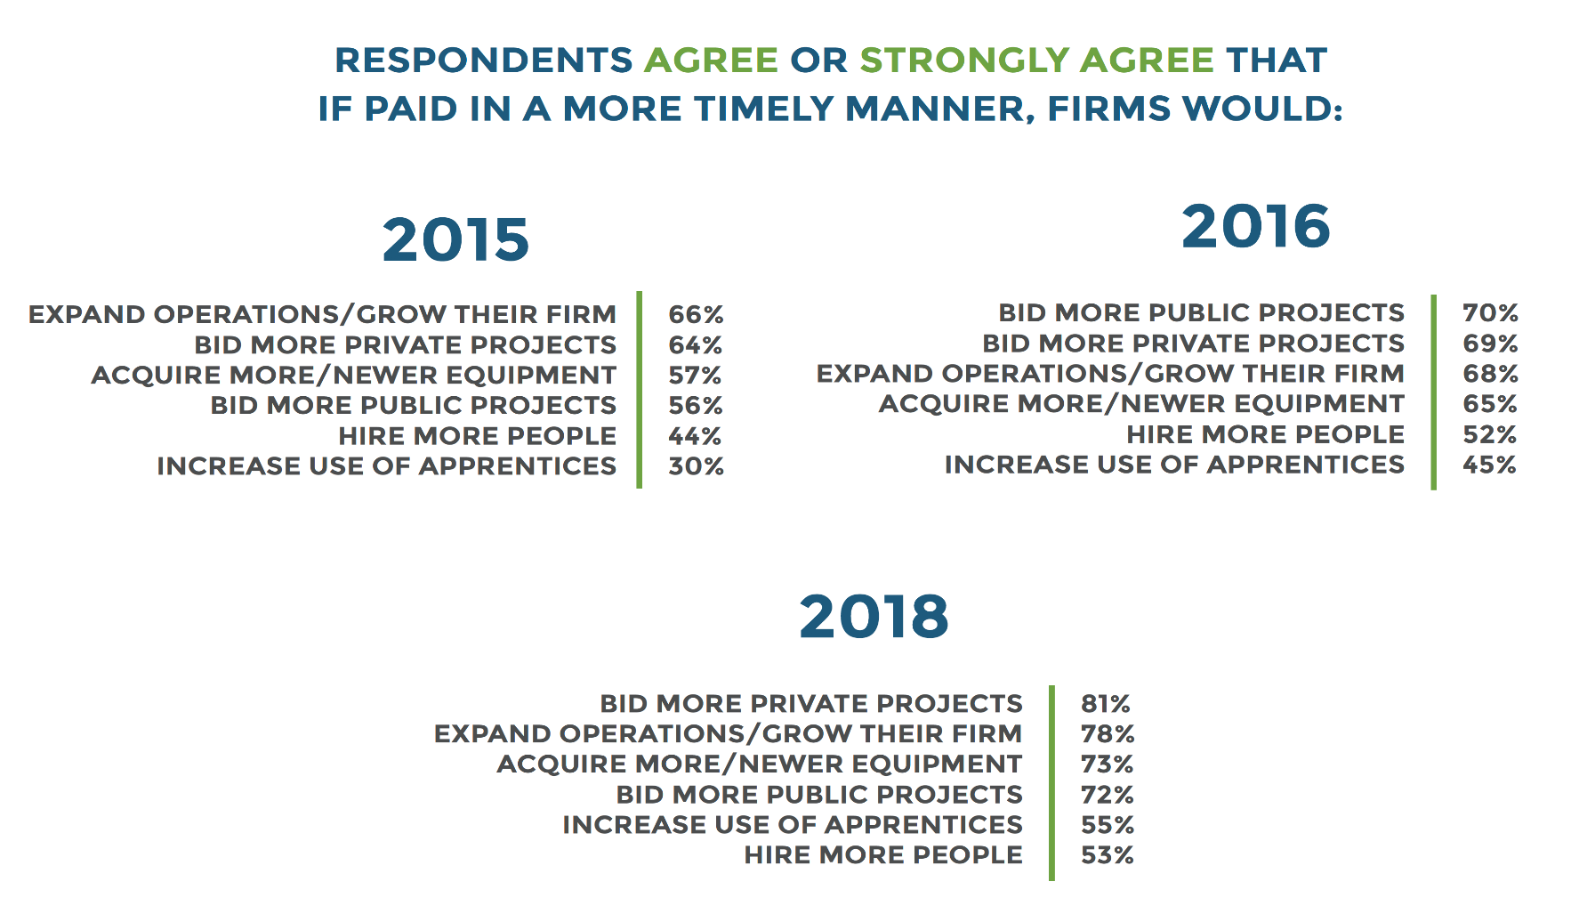
IF DELINQUENT PAYMENT WERE RESOLVED

Slide 20
WHY PROMPT PAYMENT LEGISLATION?
The Act will set out minimum payment requirements and will have a systematic approach to how money will be released with rights and responsibilities set forth for all parties to a construction project.

Slide 21
WHAT ARE RISKS FOR GOVERNMENT?
Industry is supportive of the recommendations.
These initiatives align with the recommendations of the Ivany Report, the efforts of government to reduce red tape.
Better alignment with other jurisdictions.
Some will complain that this measure will impact their freedom of contract – it does not. Legislation provides reasonable parameters to ensure fairness of contract and set out minimum rights, responsibilities and processes that apply to all parties to a project.

Slide 22
OUR ASK OF GOVERNMENT
Industry is committed to supporting government to enact model legislation that is progressive and responsive.
We are asking that government immediately begin to work with our Coalition to formulate and bring forward legislation before the end of 2018.
We are asking government to name a champion who will work with industry to advance Prompt Payment Legislation in Nova Scotia.

Slide 23
PROMPT PAYMENT COALITION PARTNERS

Slide 24
OUR INTENTIONS AND NEXT STEPS
Our intentions and next steps:
To support government publicly on this initiative.
To educate all MLAs about these important initiatives and recommendations.
To meet with each caucus and ask for their full support.
To ask for support from all MLAs on this initiative.
To launch a social media campaign and engage members from across the Province.
.

Slide 25
THANK YOU!

